Slide 1

Hebron High School Class of 2022
Senior information
Notes:
Welcome

Slide 2
STAAR/EOC Testing
  Students must pass all EOCs to graduate.
  Fall Makeup/retake tests Will be the week of December 7th and 13th Spring Makeup/retake exams will be the week of April 5th and May 3rd
  Students will be contacted by the campus testing coordinator for any makeup/retake exams.
Notes:
Latasha

Slide 3
College Applications
Most college Applications are open Now – Know your deadlines!
Most Public and Private Schools in Texas: Apply Texas Website https://goapplytexas.org
Many out of state and Private Schools, some Texas schools https://www.commonapp.org/
Some schools post their separate applications on their Individual Colleges/Universities Admissions Sites
Check the College Admissions Page Checklist to ensure you have submitted all Required documents
Notes:
Jessica

Slide 4
Where should I even apply?
Why “safety” if I don’t even want to go there?
I don’t think I’m going to get in to my “reach” school. Why should I apply?
What if I only want to go to one school? Why do I need to apply to four different institutions?
Notes:
Jessica

Slide 5
Applications: Community college*
Common Necessary Documents for a community college application:
  1. community college application (almost always online—sometimes texas app, sometimes their own app)
  2. high school transcript—must have a graduation date (**--if no grad. Date yet, fill out the crc)
  3. proof of meningitis vaccination
  4. assessment testing (for Community college, tsi)
  5. new student orientation
  6. campus safety training
  7. if you were a dual credit student, no need for further permission slips ☺
  8. if you were an ap student, will need to get scores from college board sent to cc after 3 credit hours have been earned at the community college
* Note: these steps are based off of collin community college’s admissions requirements
Notes:
Always helpful to apply early!

Slide 6
Applications: four-year university*
Necessary Documents for a four-year university application:
  1. four-year university application (for in-state, public schools almost always apply Texas or common app.)
  2. non-refundable application fee (typically $50-$100)
  3. assessment testing (typically sat or act scores)
  4. high school transcript—must have a graduation date and must be sent electronically
  5. admissions essay on application
  6. letters of recommendation
  7. resume
  8. proof of meningitis vaccination
  9. if you were a dual credit student, will need to turn in collin and hebron transcripts
  10. if you were an ap student, will need to get scores from college board sent to university. Note: universities will judge ap test scores differently!
* Note: these steps are based off of university of texas at dallas’ admissions requirements
Notes:
Always helpful to apply early!

Slide 7
College application timeline vocabulary to know
Early Decision | Early Action | Priority Deadline | Regular Decision
Commitment to attend if accepted | Indicate first choice and receive notice early | Increase odds of being admitted and receiving scholarships | Deadlines are usually Jan. 1-Mar. 15 for next Fall
Must cancel all other applications if accepted (or you forfeit a fee) | Not committed to enroll at institution | Encourages students to apply early | May apply to other colleges
Typical for Ivy League/Private Universities | Shows interest in the school | Not binding | Runs into other scholarship deadlines
Can be as early as October 15th | Typically around November 1st | November 15th for most public schools | Common Due Date: The Friday before MLK Day in January
Notes:
Jessica

Slide 8
Be Professional
Your application is a reflection of yourself.
It is important that you make your application look professional.
Have someone proofread for spelling – if you’re not sure, look it up
If you don’t already have one, create an appropriate email address
Make an appointment with your counselor if you need help
Notes:
Latasha

Slide 9
College app. essays: tips and tricks
Common questions include:
  Tell us your story. What unique opportunities or challenges have you experienced throughout your high school career that have shaped who you are today?
  Most students have an identity, an interest, or a talent that defines them in an essential way. Tell us about yourself.
  You’ve got a ticket in your hand – Where will you go? What will you do? What will happen when you get there?
The goal: link your personality with your story with the institutional mission
Write well, with good grammar, without any typos
Demonstrate mature, appropriate self-reflection as well as passion and personality!
Notes:
Always helpful to apply early!

Slide 10
HHS Transcript Requests
Transcript requests are all online
https://lewisvilletx.scriborder.com/
Our Campus Registrars process your requests once you have submitted them on this site
Make sure to put your cell number on the request– you will receive a digital receipt when the transcript has been sent from the system
First 5 transcripts are free. $5 for each subsequent request. Final transcript is also free, at the end of the school year (You will request this one in May…not right now!)
They go digitally, but it sometimes takes colleges up to 2 weeks to download your uploaded transcript from their system
Apply. Submit your application. THEN submit your transcript request.
Notes:
Latasha

Slide 11
Transcript Requests: What if I haven’t completed high school?
The good news? Most colleges and universities will accept a high school transcript without a graduation date on them
Typically called a “Conditional registration contract”
An agreement between the student and their institution to waive the transcript hold, in order to get registered, on the promise that the student, once they graduate, will send in the transcript with the hs grad. Date on it
Bottom line: send what you have now, fill out the transcript waiver, submit final transcript upon high school graduation
Notes:
Jessica

Slide 12
Rank in Class
The class of 2022 will have an opportunity to Opt out of having rank post on the transcript.
The Default Setting is for Rank to Post on the transcript
All students in the top 10% will have their rank post, regardless of choice
The window to opt-out will be September 15-30
  No decision will leave rank on the transcript
  The window is the only time these decisions will be adjusted. Research Now!
Students need to contact universities/colleges they are interested in attending to find out specific choices for those specific institutions. Every college will have a different view.
Please visit the LISD website on rank for more information here: https://www.lisd.net/Page/20087
Notes:
Latasha

Slide 13
College Research & Visits
NorTex College Fair
  Hosted by UNT, TWU, And NCTC. Over 100 colleges and universities participate every year
  This year– September 13th from 6:30-8:30 at Golden Triangle Mall in denton
NACAC Digital College Fairs - https://www.nacacfairs.org/virtual
Virtual College Visits: Most colleges are offering virtual visits and information sessions. Visit the campus’ admissions websites to participate in a session.
In-Person College Visits:
  Many campuses are offering on-campus visits and tours. The Websites of the Admissions Offices for the universities/colleges will have school-specific information
  Seniors may participate in college visits for up to two (2) school days per academic year. College visit days do not count as absences on the attendance record as long as proper documentation of the visit is returned to attendance within 2 school days following the visit.
Notes:
Jessica

Slide 15
Career / Major Research
Choices 360 –
  Program through the district to help students research colleges, majors, careers and scholarships
  Students log into LHUB, Click on ”Choices 360”, and log in using the district login
Texas On-Course –
  Resources through the state of Texas to help with college and career planning
  https://texasoncourse.org/students-and-families/grade-late-high-school/
Notes:
Latasha

Slide 16
Recommendation Letter Requests
If your College Requires a Recommendation, Print the Counselor Recommendation Packet https://www.lisd.net/Page/24487
There is a Student section and a parent section. Complete both. Scan and email the entire packet to your Counselor
The packet is due 2-weeks before the actual recommendation is due to the organization
Include a copy of your resume. It is always Very Helpful.
All recommendations are mailed or uploaded directly from Hebron. They are not given to a student or parent to mail
Recommendations are confidential documents– make sure to check the box to waive the right to see the letter in common app. Acknowledge it by signing the waiver on the rec packet.
Notes:
Latasha

Slide 17
Résumés
Many colleges and scholarships will require a résumé
Keep track of extracurricular activities, awards, clubs, organizations and community service
Leadership positions should also be included
Include activities from high school
Notes:
Jessica

Slide 18
Testing: SAT / ACT / TSI / ASVAB
College Board & ACT are adding and adjusting dates for SAT and ACT for this school year
  Register for the SAT: https://collegereadiness.collegeboard.org/sat
  Register for the ACT: http://actstudent.org
  Some universities are offering “Test-Optional’ opportunities for admission. However, test scores may still be required for competitive scholarships and honors programs. Speak with the university for specifics
Notes:
Jessica

Slide 19
TSI-Texas Success Initiative
The TSI must be taken prior to enrollment in a Texas public college, university or technical school.
This test helps colleges determine if you need to take remedial courses prior to your regular coursework.
Exemptions:
  ACT composite of 23 with a minimum of 19 on both the English and Math tests.
  SAT combined verbal and math score of 1070 with a minimum of 500 on both the verbal and math sections.
*You May Not Need To take the TSI
Notes:
TSI stands for Texas Success Initiative
This is included for Dual Credit Classes and Concurrent Enrollment

Slide 20
ASVAB
The ASVAB (Armed Services Vocational Aptitude Battery) – will be offered on campus November 18th and March 29th . Registration is currently open for the November Offering. Visit the Counseling Office to sign up.
  If you want to take the asvab outside of our window, Please contact a recruiter to schedule the test
Notes:
Latasha

Slide 21
Financial Aid
https://studentaid.gov/
FAFSA: Free Application for Federal Student Aid
Both the student & Parent must apply for a pin to use the application. Apply for PIN now
FAFSA is available to complete on October 1
TASFA: Texas Application for state financial aid (non-citizens who are Texas residents
Financial Aid Virtual Event Scheduled Sept. 15th at 6PM
The University financial Aid office for the school you are looking to attend can also help answer any questions
Notes:
Jessica

Slide 22
Scholarships
School-Specific scholarships can be found on the University websites
Schools will either have a separate scholarship application, or they will automatically use the application used for admission as a generic scholarship app. Visit the school websites for specific requirements
Sample Scholarship Searches:
  https://www.unigo.com/
  https://www.fastweb.com/
  https://www.scholarships.com/
  https://www.careeronestop.org/
LEF (Lewisville Education Foundation) https://www.lisdef.com/student-programs/scholarships/
  This is available starting in November – Closes in January
  Scholarships for district programs & organizations
Notes:
Jessica

Slide 23

Finding Money for College
Wednesday, September 15th, From6-7PM
Webex Link
Password: FA2021
Notes:
Latasha

Slide 24
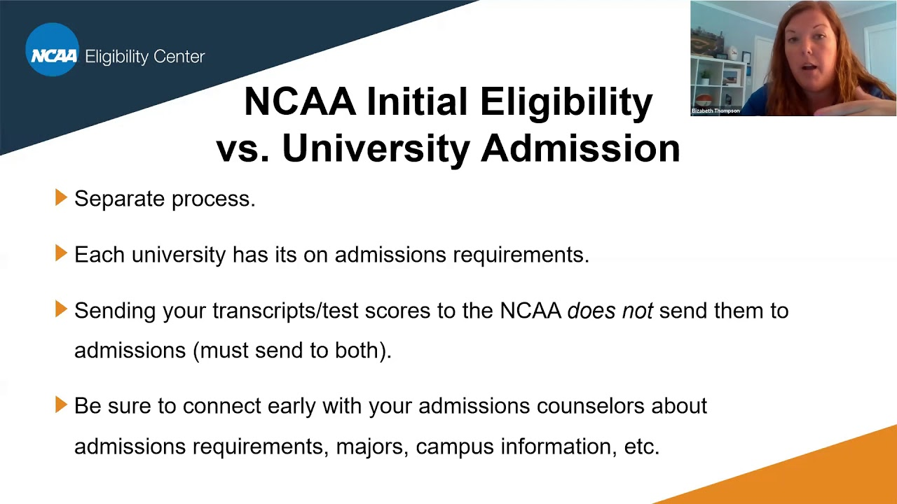
NCAA
it’s own
https://web3.ncaa.org/ecwr3/
Notes:
Latasha

Slide 25
Top 10%
You may qualify for automatic admission to many public universities in Texas through the Top 10% Rule. To meet the requirements, you must graduate in the top 10% of your class at a recognized public or private high school in Texas or a high school operated by the U.S. Department of Defense and be a Texas resident or eligible to pay resident tuition
The University of Texas has an exception to the Automatic admission rule. The class of 2022 can receive automatic admission if students are in the top 6% of the class.
Note: Some Texas students who are not offered admission to UT Austin may be invited to be part of the Coordinated Admission Program (CAP) or Path to Admission through Co-Enrollment (PACE), in preparation for admission to the university for a future term.
Notes:
Latasha

Slide 26
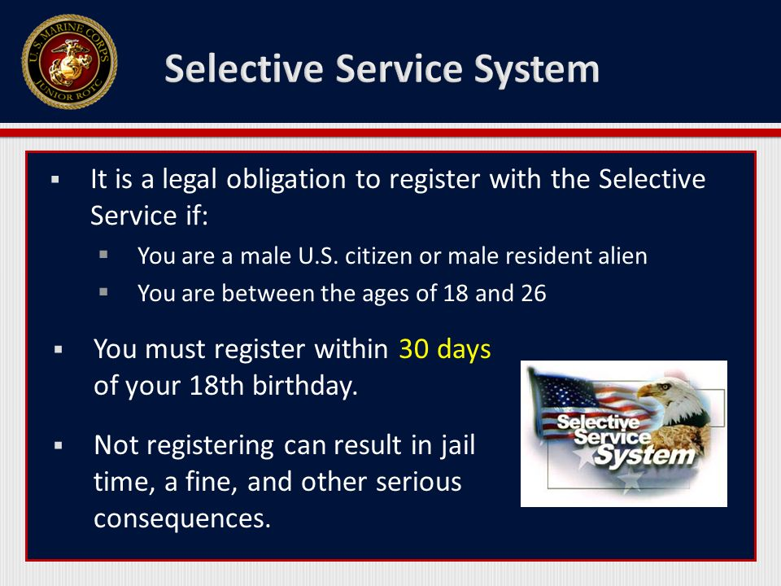
Male Students, age 18 or near:
Notes:
Latasha

Slide 27

Register to Vote: If you’re 18, then you can vote!
Notes:
Latasha

Slide 28
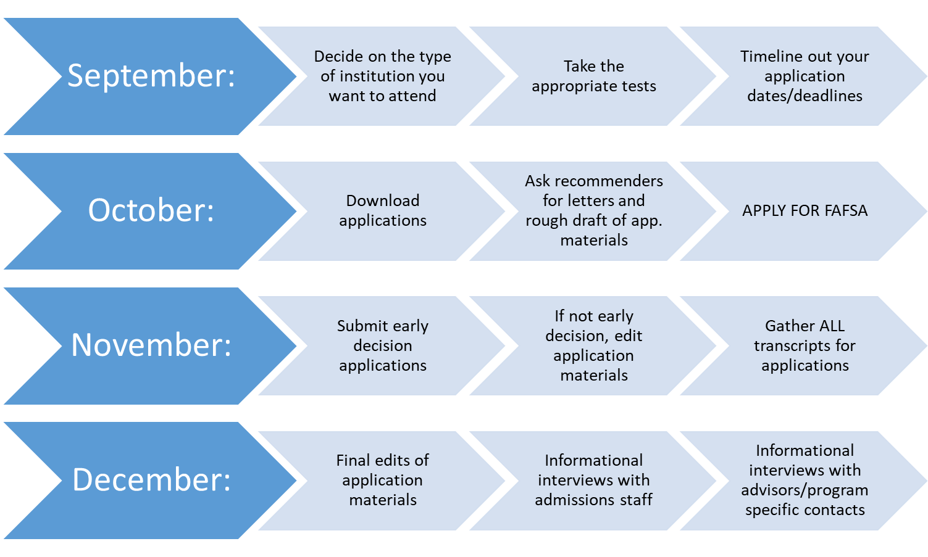
Timeline: what should I do each month to get ready?
Notes:
Jessica

Slide 29
Resources On Campus
Stephanie Valle– valles@lisd.net
  Student Assistance Counselor (social emotional concerns)
Collin College – Dr. Jessica Robinson – jArobinson@collin.edu
  will be on campus five days a week
  Helps with all things ‘college’
    Research, scholarships, applications, financial aid, dual credit admissions
UNT G-Force
  Help with all things ‘college’
  Current College Students that have just been through college, scholarship and financial aid applications assisting our seniors.
Notes:
Latasha

Slide 30

Notes:
Latasha

Slide 31

Need More Info?
Contact your Hebron high school Counselors:
  Mrs. Rayford (A-Car) rayfordlm@lisd.net
  Ms. Cheng (CAS-fe) chengP@lisd.net
  Mrs. Lovett (fi-h) lovetts@lisd.net
  Mrs. Hood (I-li) hoodm@lisd.net
  Dr. Fields (lo-mi) fieldsjr@lisd.net
  Mrs. Bradley(mo-q) bradleyj@lisd.net
  Mrs. Clingan (r-St) clingank@lisd.net
  Mrs. Renee (Su-Z) reneej@lisd.net
Want to talk to a collin representative about colleges and careers?
Contact Dr. Jessica Robinson, CCC for Hebron high school at jarobinson@collin.edu
Notes:
Jessica

